Slide 1


Semipalmated Sandpiper US Atlantic Coast Migration Stopover Site Analysis
Semipalmated Sandpiper (SESA)
Calidris pusilla
Carissa Rego Bryant University MSDS640 Capstone

Slide 2
Agenda
1.
Background and Motivation
2.
Data and Methods
3.
Results
4.
Discussion
5.
Conclusion

Slide 3
Agenda
1.
Background and Motivation
2.
Data and Methods
3.
Results
4.
Discussion
5.
Conclusion

Slide 4
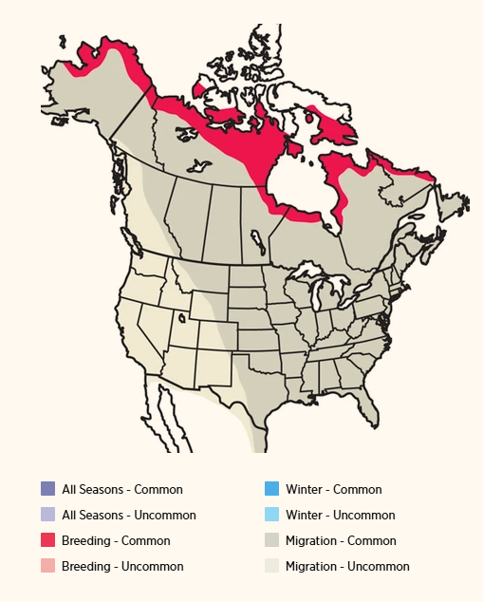
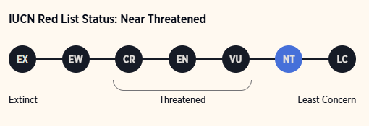
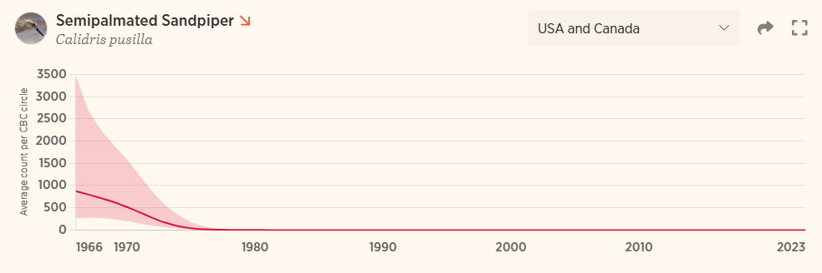
Semipalmated Sandpiper (SESA)

Slide 5
Problem Statement and Motivation
Semipalmated Sandpiper - Migration | Bird Migration Explorer
Stopover sites along the US Atlantic Coast are essential to the success of migration
Threats to these stopover sites include
Habitat loss
Land cover changes
Coastal development
There are a limited number of studies done using quantitative models to predict stopover site usage using citizen science data (ebird)
Benefits: conservation scientists, coastal land use planners, wildlife managers, government agencies (state and federal)

Slide 6
Research Question and Hypothesis
Research Questions
What habitat and land cover characteristics predict SESA stopover site usage?
Have detection rates at stopover sites changed over time?
Hypothesis
SESA stopover site usage is predictable using land cover characteristics (particularly the presence of coastal wetland habitats).
Sites that have experienced habitat degradation between the years 2001-2025 will be less likely to be used as stopover sites and therefore will have a lower chance of SESA being present.

Slide 7
1.
Background and Motivation
2.
Data and Methods
3.
Results
4.
Discussion
5.
Conclusion

Slide 8
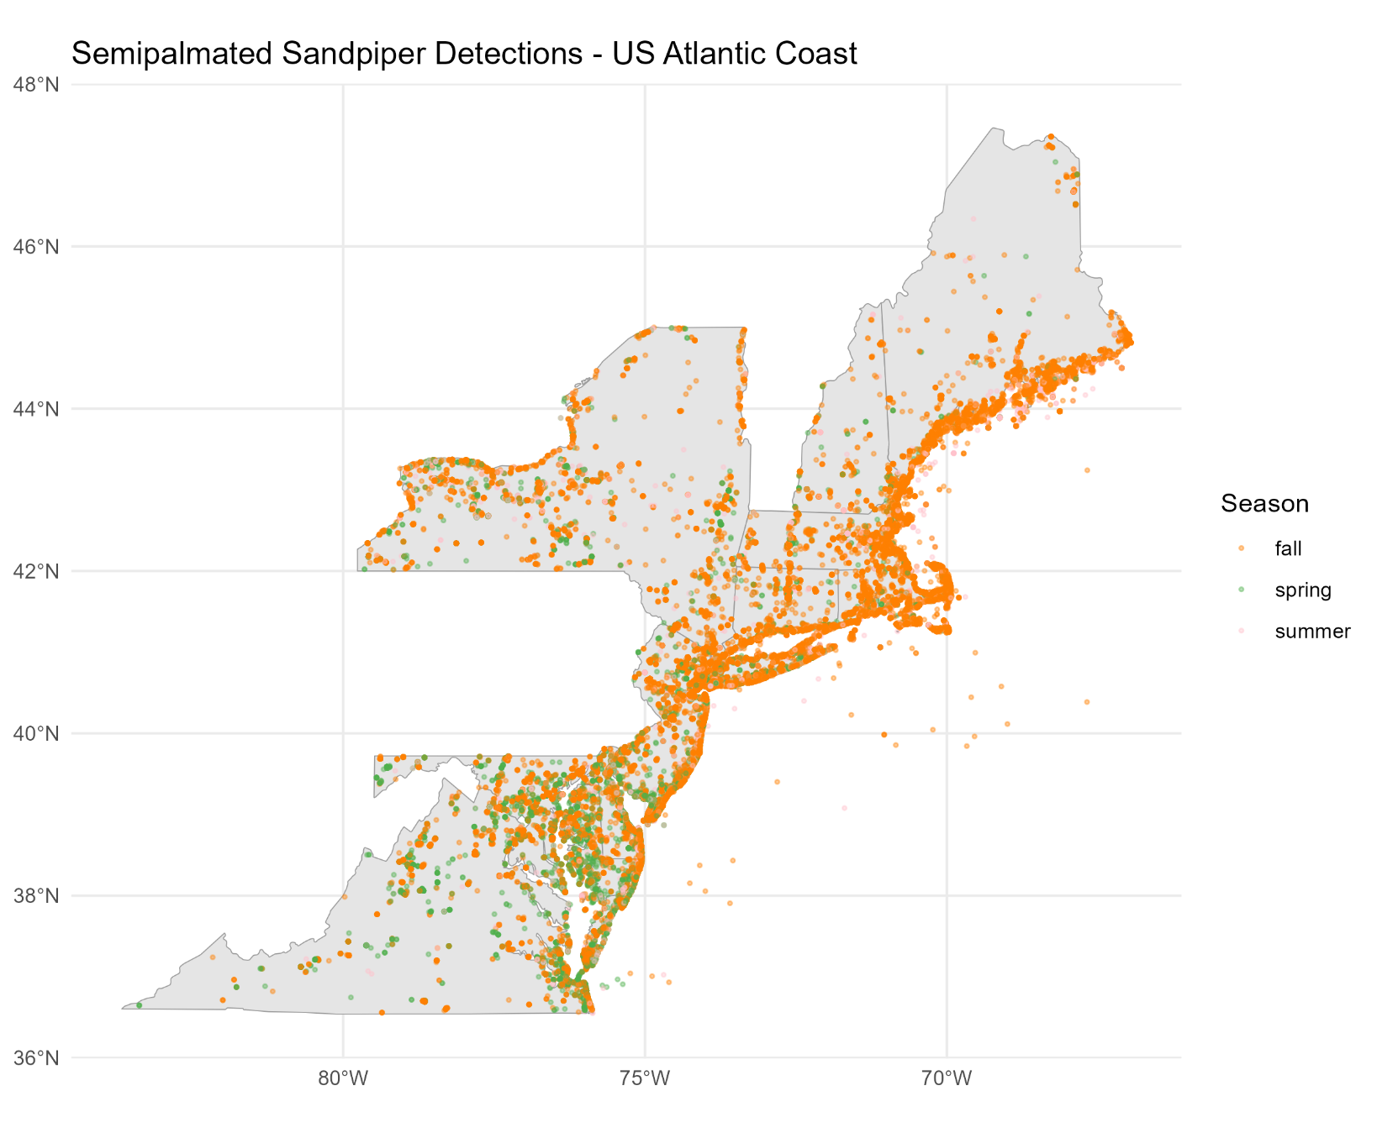
Data Overview
Data Source: eBird, Cornell Lab of Ornithology
~12 million total checklists, ~6 million complete checklists
Study Area: 10 US Atlantic Coast States
Connecticut, Delaware, Maine, Maryland, Massachusetts, New Hampshire, New Jersey, New York, Rhode Island, and Virginia.
Study Time Range: May-September 2001-2024
Final Dataset: 1,495 total locations (499 presence, 996 absence)
Checklist-based absence approach - true absences obtain from completed checklists

Slide 9
Predictor Variables and Feature Engineering
Predictor Variables:
NLCD land cover classes
Removed shrub scrub
Elevation (elevatr)
Distance to Coastline (NaturalEarth)
Climate data (NASA POWER)
Wind speed
Temperature
Precipitation
Engineered Features:
Land cover changed
Habitat degraded
Habitat improved

Slide 10
EDA
Land cover at presence sites is dominated by four classes
Developed low intensity
Emergent herbaceous wetlands
Open water
Developed open space
13.1% of sites experienced land cover change from 2001-2025
No severe multicollinearity
features from 2001 were removed after creating habitat change columns

Slide 11
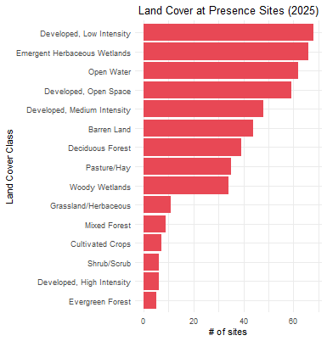
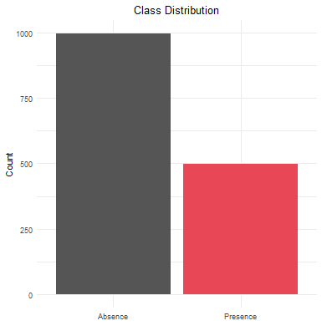
EDA

Slide 12
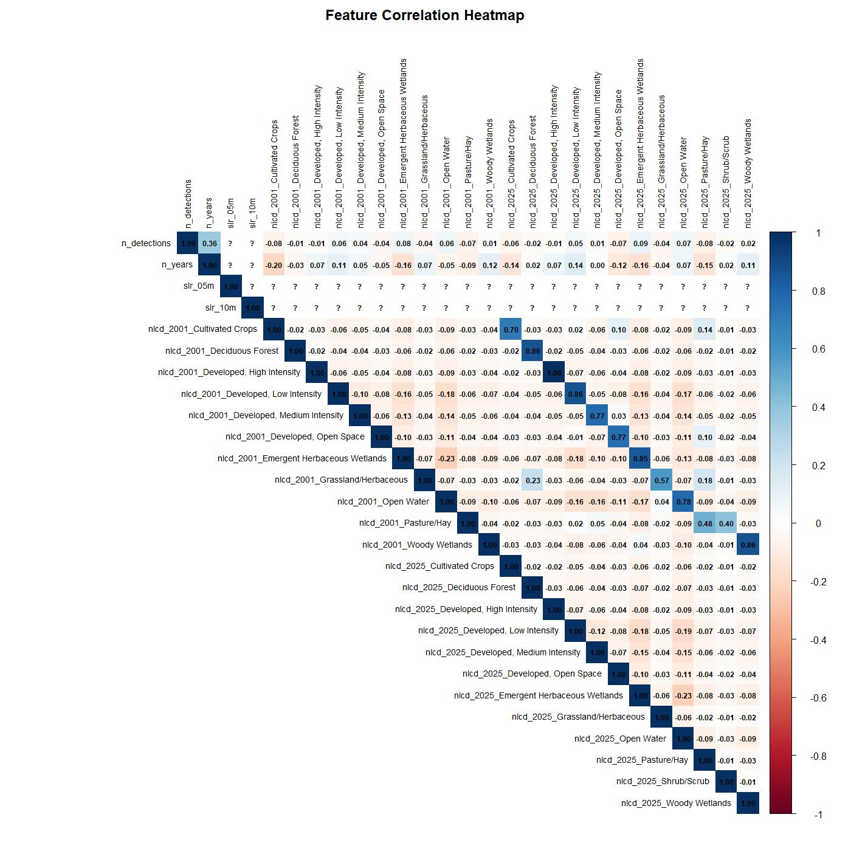
EDA

Slide 13
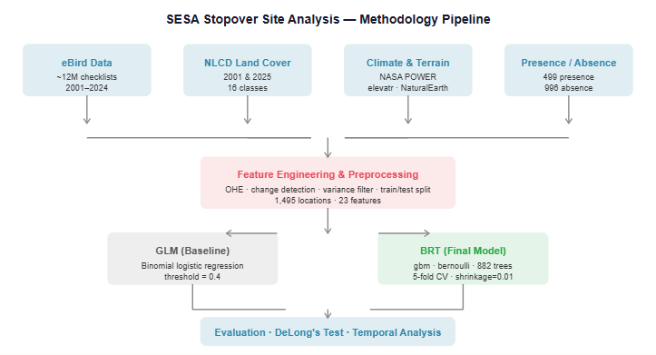
Methodology Pipeline

Slide 14
Methodology
Two Models
Baseline: Logistic Regression (LR)
Threshold adjusted from 0.5 to 0.4 to increase recall
Improved: Boosted Regression Trees (BRT)
882 optimal trees, learning rate = 0.01, interaction depth = 5
70/30 train test split
set.seed(42)
5-fold CV for both models

Slide 15
Methodology
Naive Baseline: majority class classifier (absences), 66.7% accuracy
AUC-ROC was the primary metric used to evaluate
It is robust to class imbalance and is not contingent on the threshold set
Secondary evaluation metrics
Accuracy, precision, recall, F1
Delong’s test was used for statistical analysis of both models

Slide 16
1.
Background and Motivation
2.
Data and Methods
3.
Results
4.
Discussion
5.
Conclusion

Slide 17
Model Results
Naive Baseline: AUC: 0.500 Accuracy: 65.7%
Metric | Logistic Regression | Boosted Regression Trees
AUC | 0.783 | 0.819
CV AUC | 0.777 | 0.803
Accuracy | 73.1 | 76.6
Precision | 0.600 | 0.706
Recall | 0.643 | 0.545
F1 | 0.621 | 0.615

Slide 18
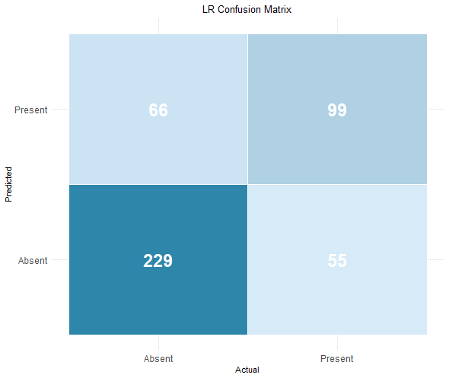
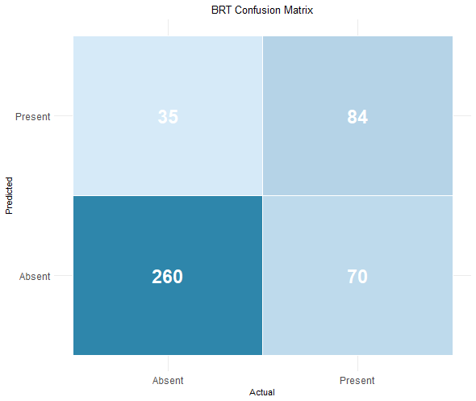
Model Results

Slide 19
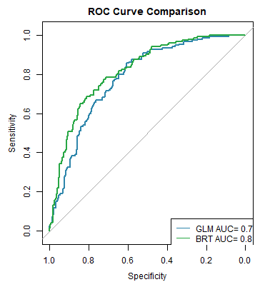
ROC Curve Comparison
Visualizing Logistic Regression and Boosted Regression Trees against the naive baseline

Slide 20
Statistical Analysis
Delong’s Test showed BRT significantly outperformed LR
Z = -2.67
p = 0.008
95% CI for AUC difference: -0.063 to -0.010
Supports BRT outperforming LR (negative values)
CV AUC close to test AUC for both LR and BRT
LR CV AUC: 0.777 + 0.030 across 5 folds
BRT CV AUC: 0.803 + 0.027 across 5 folds
No overfitting

Slide 21
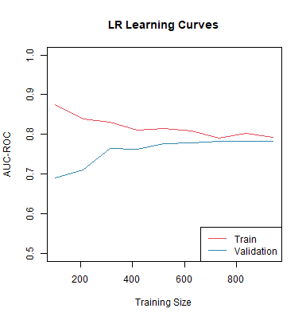
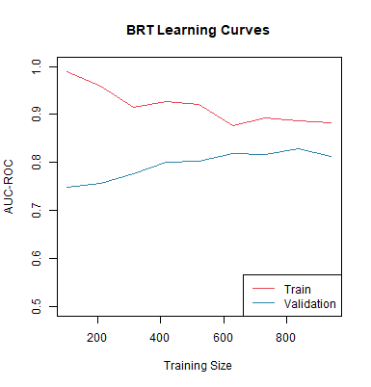
Learning Curve Comparison

Slide 22
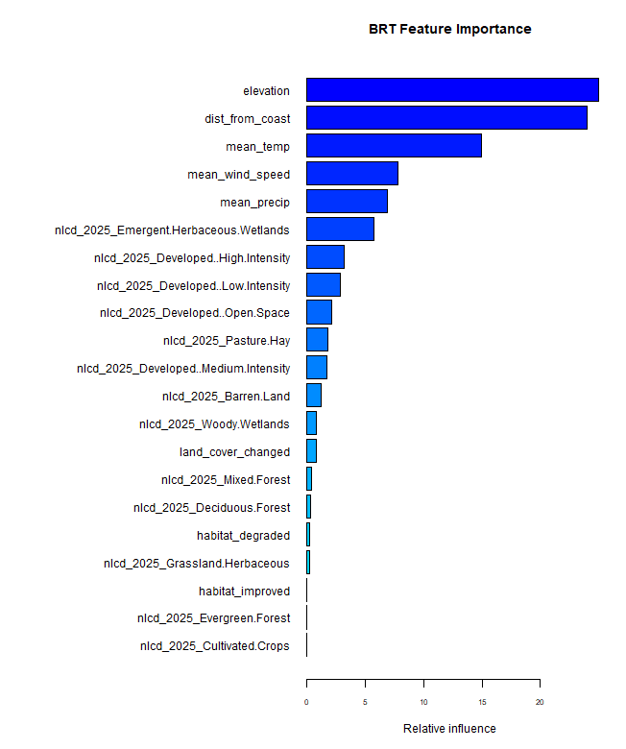
Feature Importance
50% of the model influence
Elevation: 24.97%
Distance to coast: 23.97%
Temperature: ~15%
Emergent herbaceous wetlands land cover class: 5.77%
Top land cover predictor

Slide 23
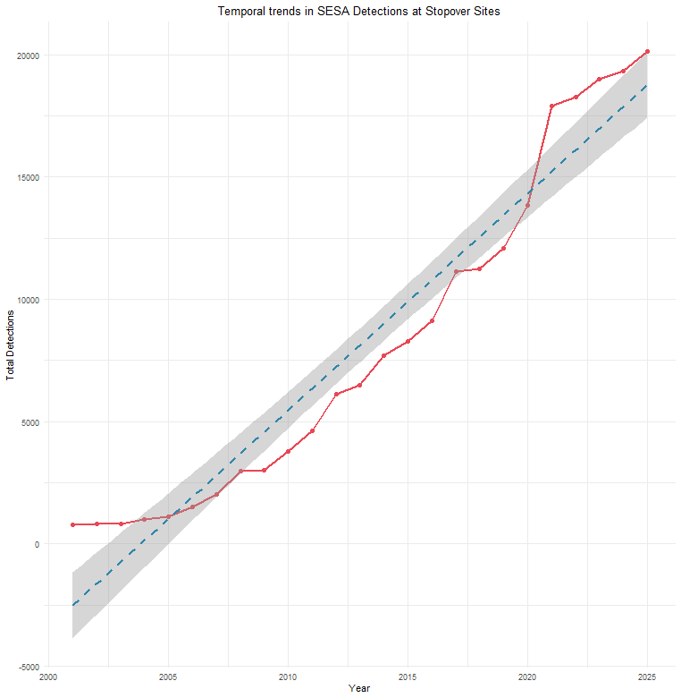
Temporal Analysis
Overall detection rate was stable
1 significantly declining site: L455080, Rhode Island
Slope = -0.036 / year
p = 3.28e-08
R² = 0.911
No habitat degradation, decline is not explained by land cover

Slide 24
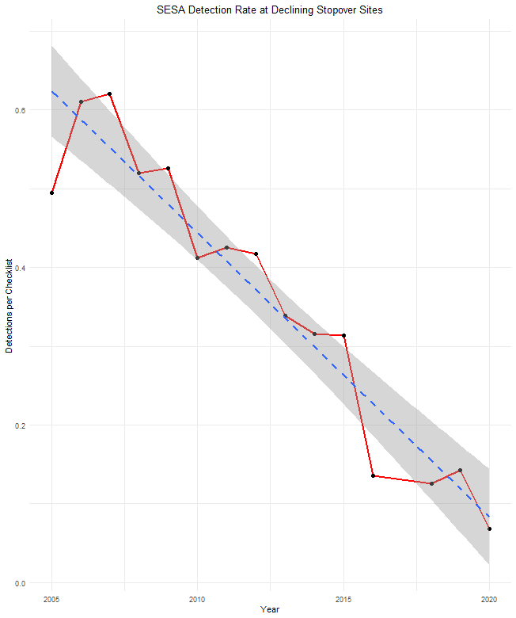
Temporal Analysis
1 significantly declining site: L455080, Rhode Island
Slope = -0.036 / year
p = 3.28e-08
R² = 0.911
No habitat degradation, decline is not explained by land cover

Slide 25
1.
Background and Motivation
2.
Data and Methods
3.
Results
4.
Discussion
5.
Conclusion

Slide 26
Discussion
My hypothesis is partially supported by my findings
Wetland land cover predicts presence, but physical features dominate predictions
BRT captures nonlinear relationships that LR cannot
Overall population decline does not show up as declining detection rates in top 500 stopover sites.
SESA are concentrated at the high quality sites
L455080 scenario points to the idea of outside factors causing detection decline
Human usage, food availability, predator presence

Slide 27
Strengths and Limitations
Weaknesses:
eBird data can be biased due to its citizen science nature - areas that are more populated or easier to access by default have more human presence
NLCD resolution may not capture fine scale habitat details
Spatial autocorrelation was not formally tested
BRT learning curves show that the model is potentially not fully converged, providing the model with more data may improve this
Strengths:
Checklist based absences are more ecologically valid than pseudo absences
BRT captures nonlinear relationships not detectable by LR
Open source and fully reproducible
Highlights a species that is showing severe declining population trends in recent years

Slide 28
Societal Impacts and Ethics
Due to model uncertainty conservation decisions should be validated with field data
There is the possibility the model could perform different depending on the areas of focus and the data available
The findings from this analysis can be used to evaluate areas that need conservation focus (expanding to >500 sites will greater allow for this evaluation)
Citizen science data is collected by volunteers, not trained scientists, which opens it up to a variety of biases such as location and identification

Slide 29
1.
Background and Motivation
2.
Data and Methods
3.
Results
4.
Discussion
5.
Conclusion

Slide 30
Conclusions
My main goal was to test whether SESA stopover site usage could be predicted using land cover characteristics.
The short answer? Kind of
Wetland land cover is a very important land cover characteristic, but no land cover characteristics are more important than the physical geography of the site.
Elevation and how close a site is to the coast are two of the most important pieces of information to have when predicting site usage

Slide 31
Key Takeaways
Physical geography is more impactful in prediction than land cover
Citizen science data has its biases and limitations, but can be a useful tool for predictive modeling
High quality stopover sites may buffer against population level declines

Slide 32
Future Work
Integrating sea level rise (slr) scenarios would be very meaningful in assessing habitat vulnerability
Occupancy modeling would aid in the biases that are inevitable when working with citizen science data like ebird
Spatial CV would improve AUC estimates by ensuring they are more conservative
Expanding to other migratory shorebird species (such as piping plovers, american oystercatchers, etc)

Slide 33
Thank you!
Questions?

